Slide 1
Subject: EEL 519 (AI and ML Tools)
An Innovative Machine Learning Framework for Feature Optimization and Anomaly Detection in PMU-Based Power Transmission System
Presented By:
Nikhil B Sardar (PhD) Department of HRE,IITR nikhil_bs@hre.iitr.ac.in | Priyanshi Agarwal (PhD) Department of EE,IITR priyanshi_a@ee.iitr.ac.in | Anjali Dhakad (Mtech) Department of EE,IITR anjali_d@ee.iitr.ac.in | Shubham Kumar (Mtech) Department of EE,IITR shubham_k@ee.iitr.ac.in | Gaurav Vinod Patil(Mtech) Department of EE,IITR gaurav_vp@ee.iitr.ac.in
Assigned TA:
Ram Singh (PhD)
Department of EE, IITR
ram_s@ee.iitr.ac.in
Presented To:
Dr. Manoj Tripathy
Department of Electrical Engg Indian Institute of Technology, Roorkee Uttarakhand, India manoj.tripathy@ee.iitr.ac.in

Slide 2
Introduction of the Proposed Model
Innovative ML Model-Based Feature Optimization and Anomaly Detection Framework for Power Transmission System.
Multiclass: No event (1), natural conditions (8), and cyber-attacks (28) [1]
Boosts both the accuracy and F1 score performance: By coupling the Innovative ML Model-Based Feature Optimization with multiple machine learning algorithms
Classifier Analyzed: Support Vector Machine, Gradient Boosting, K-nearest neighbors (KNN), Random Forest, and Decision Tree classifiers

Slide 3
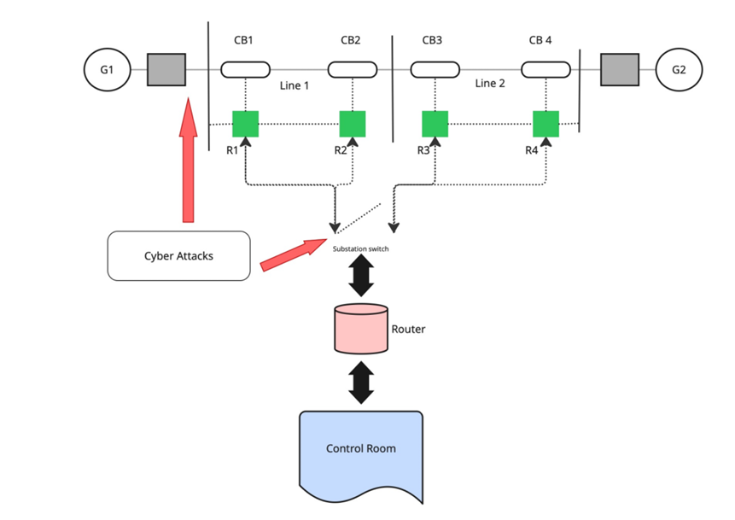
The Power System Network Under Consideration
Two Generators with Transformers [5]
2 Lines
4 Circuit breakers (CB1-CB4)
4 Intelligent Electronic Devices (IEDs)
(R1-R4) , we considered one IED for one Circuit Breaker, i.e. R1 for CB1, R2 for CB2, R3 for CB3 and R4 for CB4
Router
Control Room (Control Center)
To analyze this system, three different events have been considered : [5]
No event (Normal condition of a system)
Natural events (System Predefined Faults)
Attack events: Data Injection (DI), Remote Trip ping Command Injection (RTCI), and Relay Setting Change(RSC)
Fig 1. Power System Network Under Consideration

Slide 4
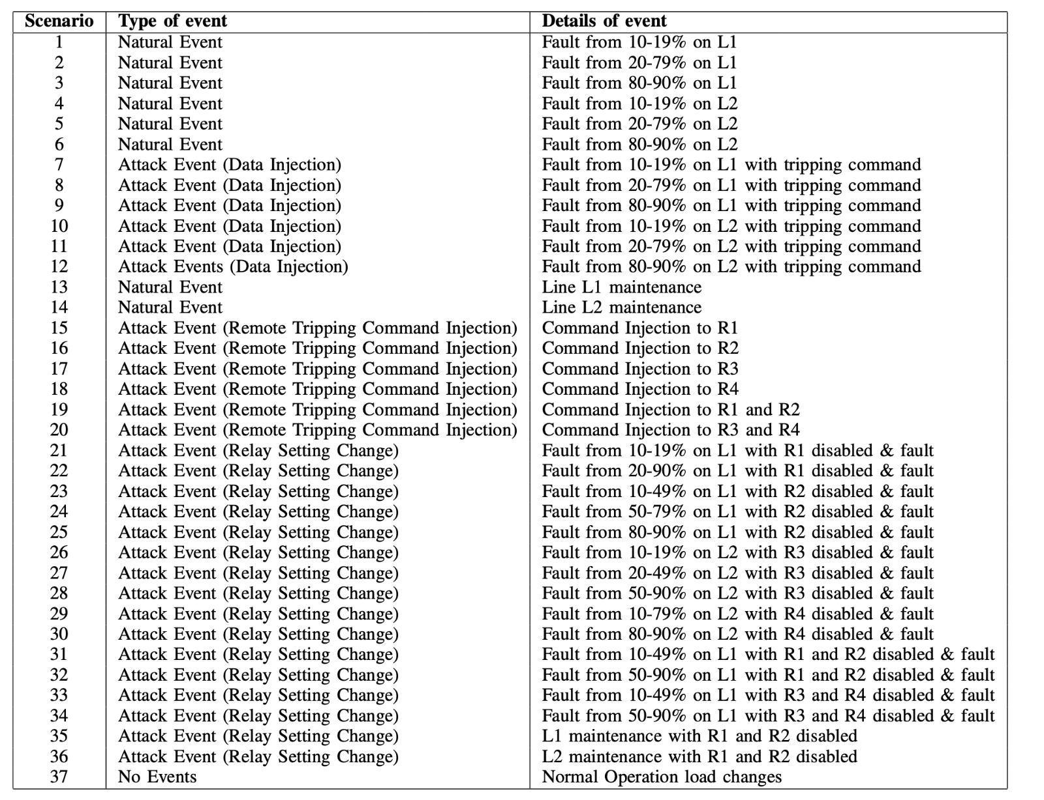
Condition of Natural Event, No event and Attack:
Types of Scenarios: [4]
Short-circuit fault – this is a short in a power line and can occur in various locations along the line, the location is indicated by the percentage range.
Line maintenance –one or more relays are disabled on a specific line to do maintenance for that line.
Remote tripping command injection (Attack) – this is an attack that sends a command to a relay which causes a breaker to open. It can only be done once an attacker has penetrated outside defenses.
Relay setting change (Attack) – relays are configured with a distance protection scheme and the attacker changes the setting to disable the relay function such that relay will not trip for a valid fault or a valid command.
Data Injection (Attack) – here we imitate a valid fault by changing values to parameters such as current, voltage, sequence components etc. This attack aims to blind the operator and causes a black out.
Fig 2. Type of Scenarios in Power System Dataset

Slide 5
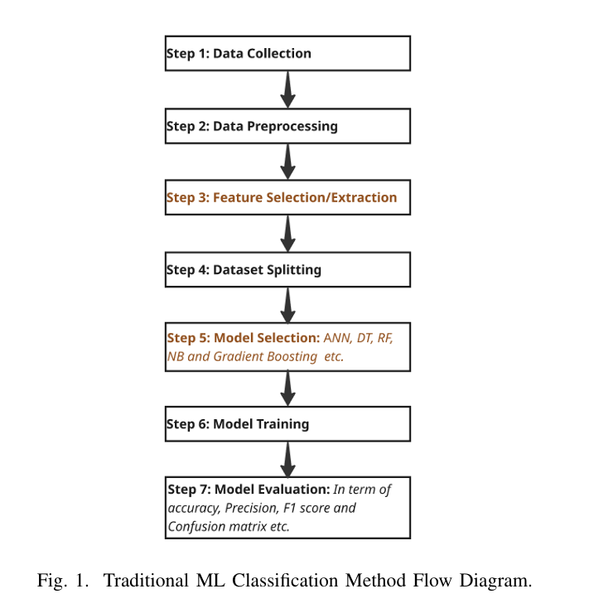
Traditional ML Classification Method Flow Diagram
Fig 3. Traditional ML Classification Method Flow Diagram [3]

Slide 6
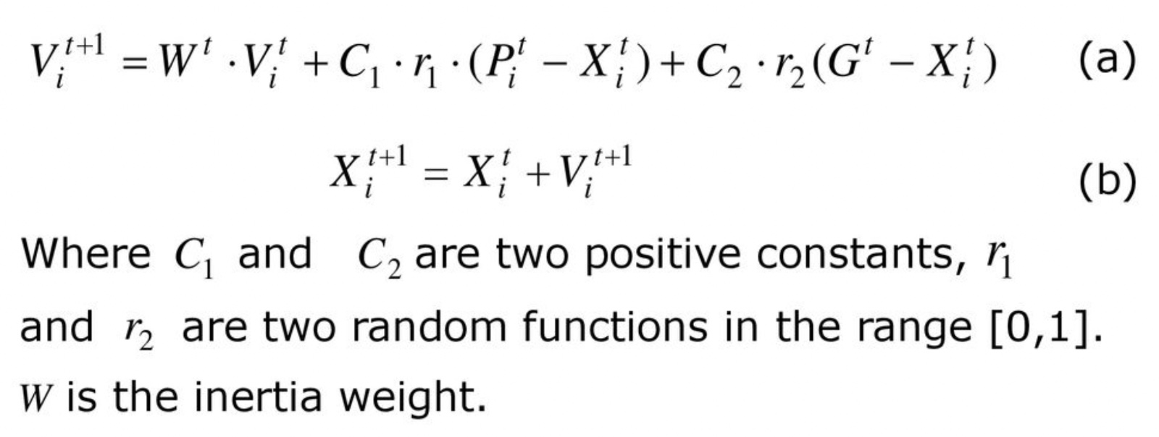
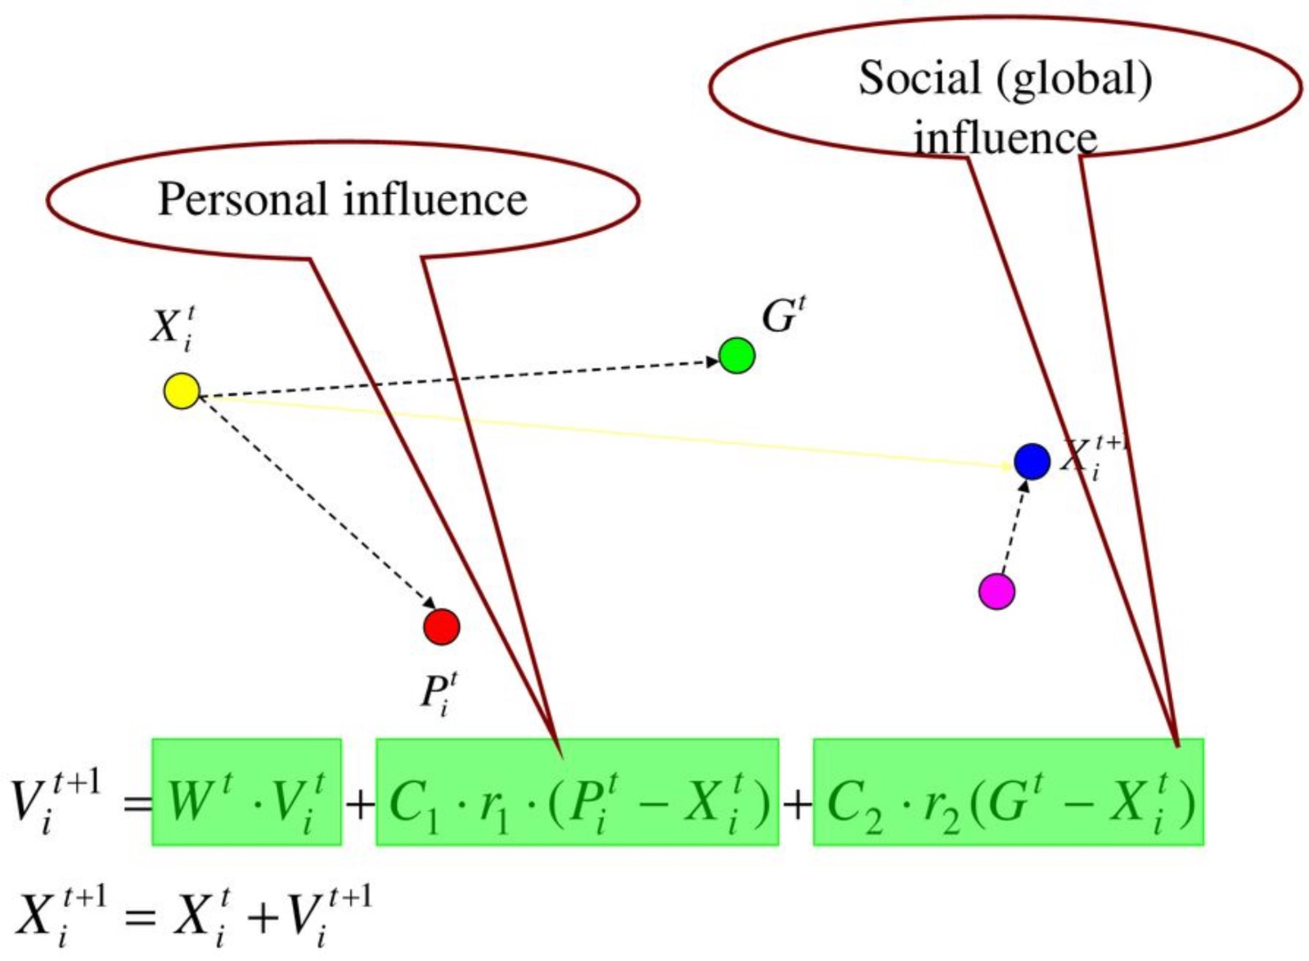
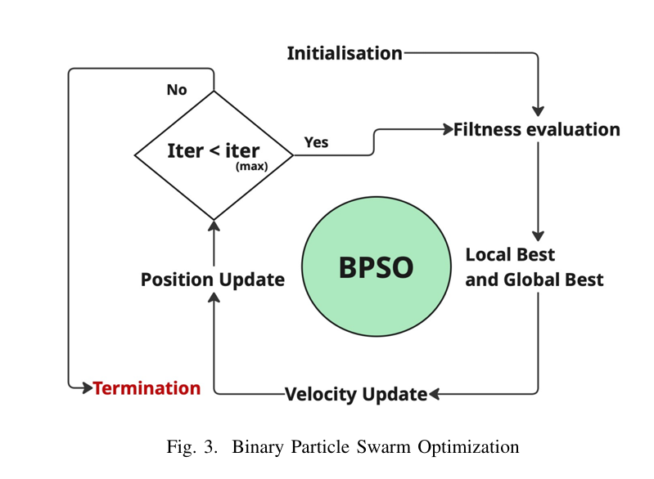
BPSO Algorithm Numerical Computation: [4]
Fig 5. Binary Particle Swarm Optimization Equations
Fig 4. Binary Particle Swarm Optimization

Slide 7
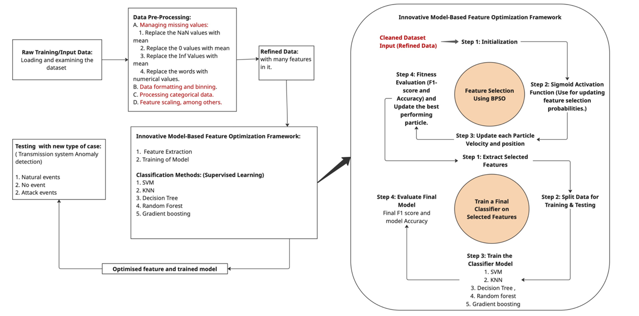
Proposed Machine Learning Framework
Fig 6. Proposed Machine Learning Framework

Slide 8
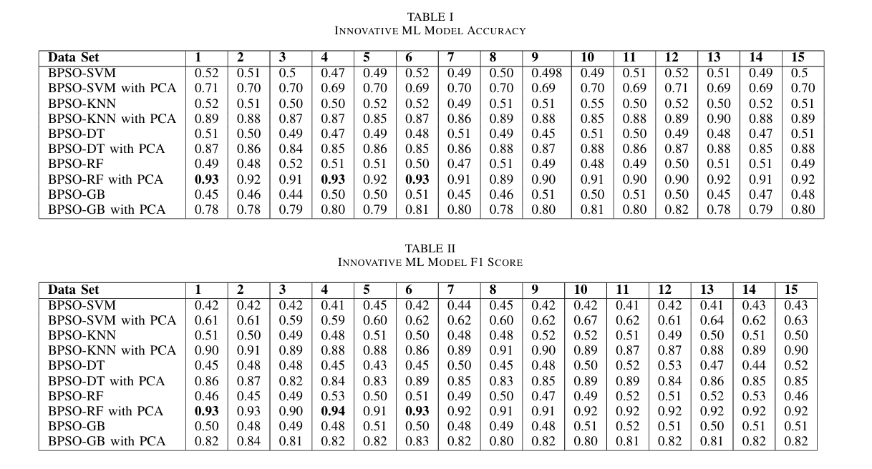
Results

Slide 9
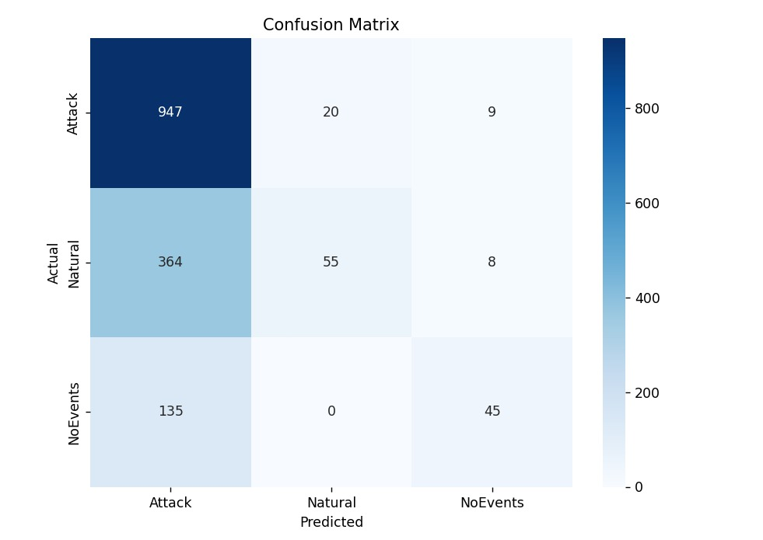
Training Confusion Matrix Achieved for the SVM
Fig 7. Confusion Matrix Achieved for SVM

Slide 10
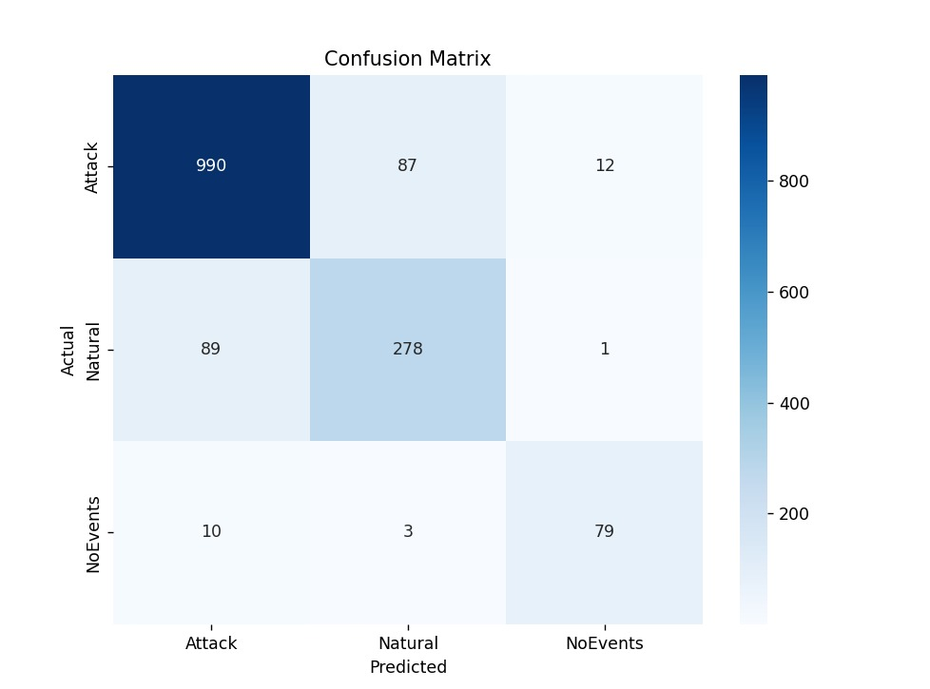
Training Confusion Matrix Achieved for the Decision Tree Algorithm
Fig 8. Confusion Matrix Achieved for Decision Tree Algorithm

Slide 11
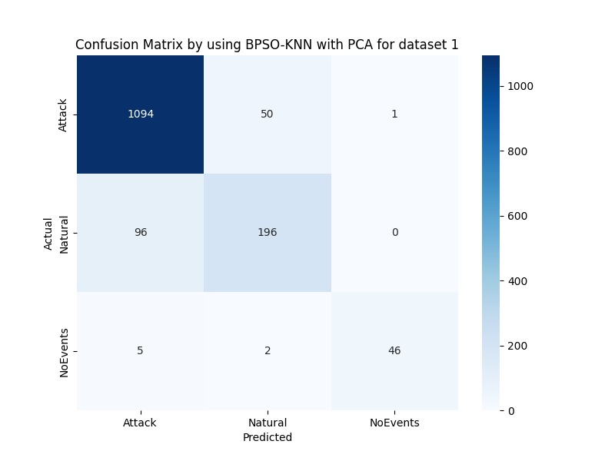
Training Confusion Matrix Achieved for the KNN Algorithm
Fig 9. Confusion Matrix Achieved for KNN Algorithm

Slide 12
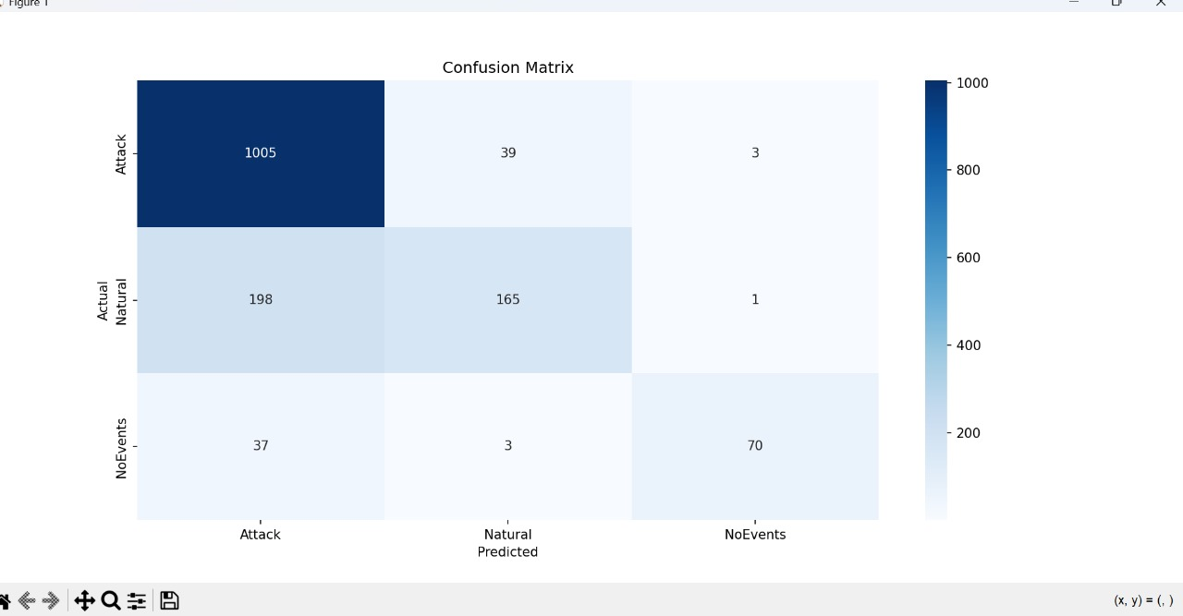
Training Confusion Matrix Achieved for the Gradient Boosting Algorithm
Fig 10. Confusion Matrix Achieved for Gradient Boosting Algorithm

Slide 13
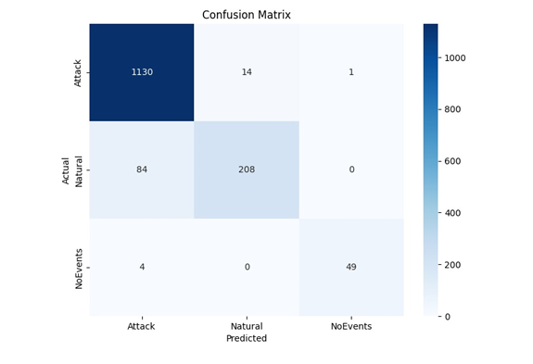
Training Confusion Matrix Achieved for the Random Forest Algorithm
Fig 11. Confusion Matrix Achieved for Random Forest Algorithm

Slide 14
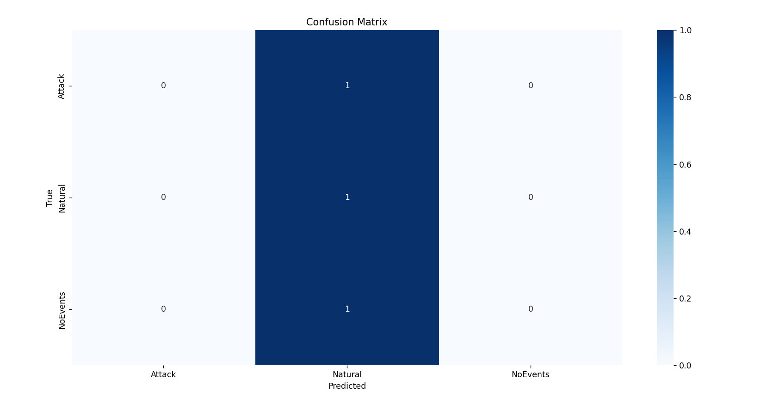
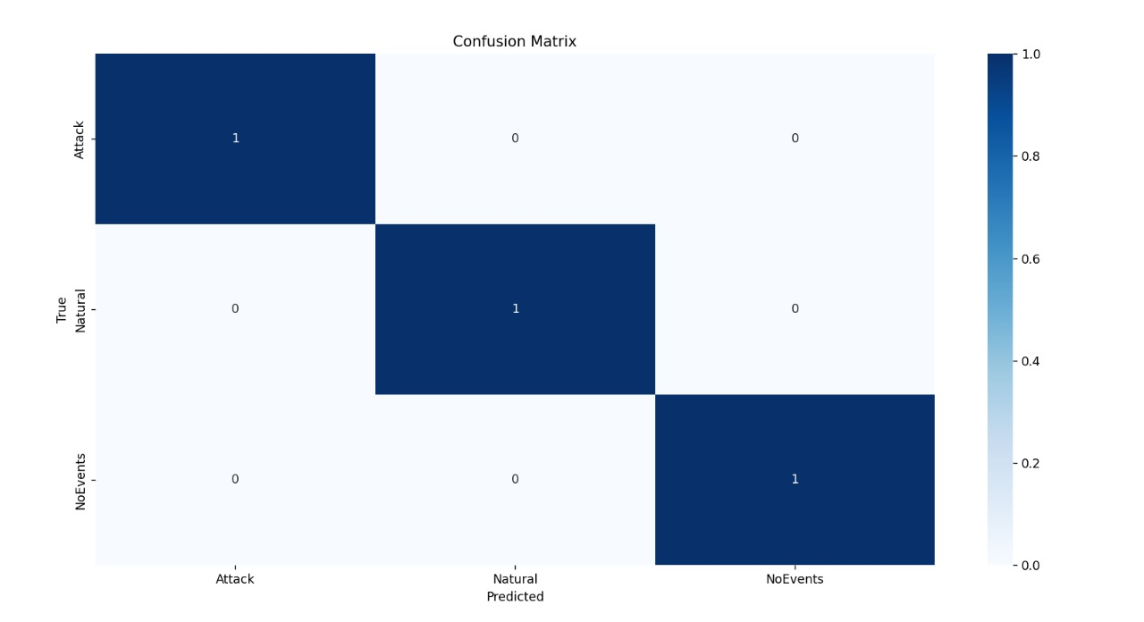
Proposed Method Testing results: Confusion Matrix
Fig 12. Confusion Matrix Achieved for KNN Algorithm for testing data
Fig 12. Confusion Matrix Achieved for Random Forst Algorithm for testing data

Slide 15
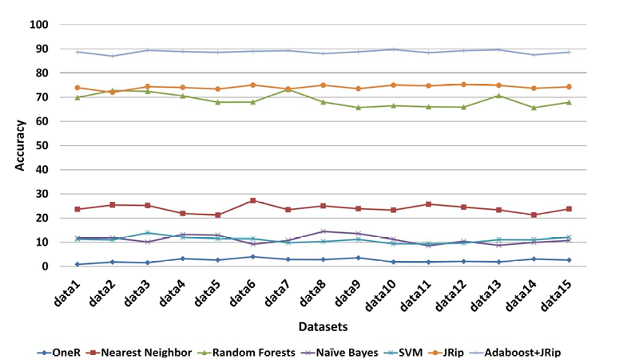
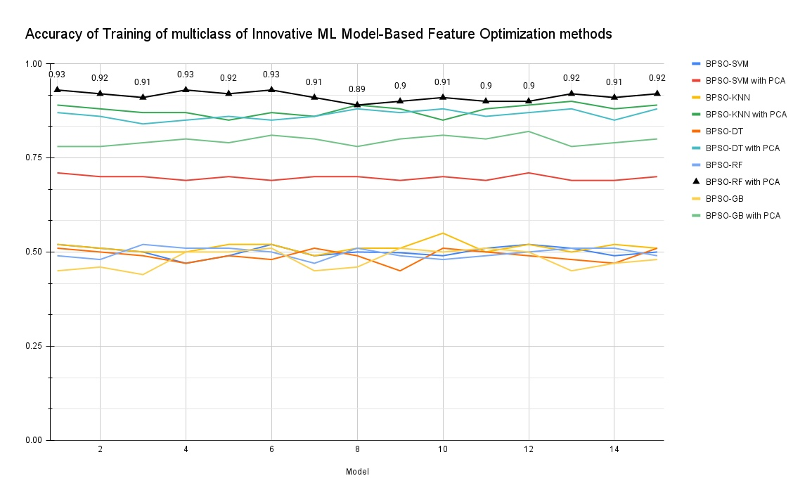
Conclusion
The study highlights the complexity of modern power systems and their vulnerability to disruptions, especially cyber attacks. As power grids become interconnected, they face challenges in maintaining operational stability. To address this, a novel model-based feature optimization framework is introduced, integrating Binary Particle Swarm Optimization (BPSO) with supervised machine learning classifiers. This hybrid technique improves classification performance by increasing efficiency and accuracy of feature selection. The framework with Random forest ML method proven to be effective in identifying optimal feature subsets and distinguishing between normal operating conditions, faults, and cyber-induced anomalies.
Fig 11. Accuracy plot obtained from various algorithms for different datasets [6]
Fig 12. Accuracy plot obtained from various algorithms for different datasets
in proposed model

Slide 16
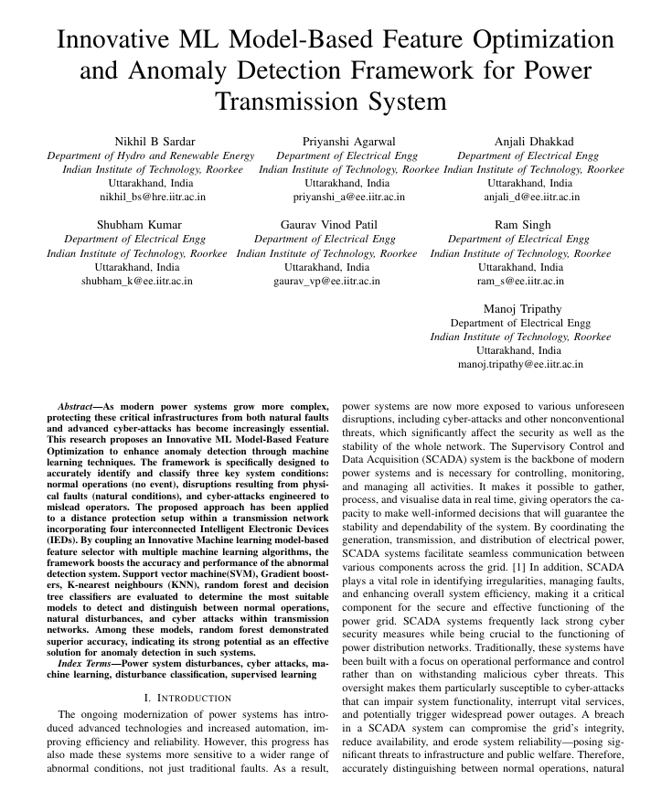

Conference paper:

Slide 17

Targeted Conference
https://www.pics2025nith.com

Slide 18
References
[1] Y. Huang, J. Tang, Y. Cheng, H. Li, K. A. Campbell, and Z. Han, adaptive CUSUM method and analysis,” IEEE Syst. J., vol. 10, no. 2, pp. 532–543, Jun. 2016. “Real-time detection of false data injection in smart grid networks: An adaptive CUSUM method and analysis,” IEEE Syst. J., vol. 10, no. 2, pp. 532–543, Jun. 2016.
[2] Y. Yuan, Z. Li, and K. Ren, “Quantitative analysis of load redistribution attacks in power systems,” IEEE Trans. Parallel Distrib. Syst., vol. 23, no. 9, pp. 1731–1738, Sep. 2012
[3] M. H. Azam, A. Ahmad, U. Altaf and S. Sarwar, ”Comparison of Genetic Algorithm and Particle Swarm Optimization for DC Optimal Power Flow,” 2023 25th International Multitopic Conference (INMIC), Lahore, Pakistan, 2023, pp. 1-5, doi: 10.1109/INMIC60434.2023.10466223.
[4] M. S. Hassan, M. A. Siddique, N. Mohammad and A. I. Ikram, ”Performance Analysis of Machine Learning-Based Traditional and Ensemble Techniques for Smart Grid Stability Prediction,” 2024 6th International Conference on Electrical Engineering and Information Communication Technology (ICEEICT), Dhaka, Bangladesh, 2024, pp. 1020-1025, doi: 10.1109/ICEEICT62016.2024.10534560.
[5] Han, Y., Wang, Y., Cao, Y., Geng, Z., Zhu, Q. (2023). ”A novel wrapped feature selection framework for developing power system intrusion detection based on machine learning methods. IEEE Transactions on Systems, Man, and Cybernetics: Systems, 53(11), 7066-7076.
[6] Hink, Raymond C. Borges, et al. "Machine learning for power system disturbance and cyber-attack discrimination." 2014 7th International symposium on resilient control systems (ISRCS). IEEE, 2014.

Slide 19
Thanks

